Slide 1
BMC Cyber and Cloud Summer Courses Deep Learning for Computer Vision Convolutional Neural Networks
Samuel Adebayo
sadebayo@belfastmet.ac.uk

Slide 2
Implementing Simple Neural Network
Introduction to Pytorch
Building a Simple Neural Network
https://colab.research.google.com/github/exponentialR/DL4CV/blob/main/Day-1-Intro-to-CV/1_2_Building_neural_networks.ipynb

Slide 3
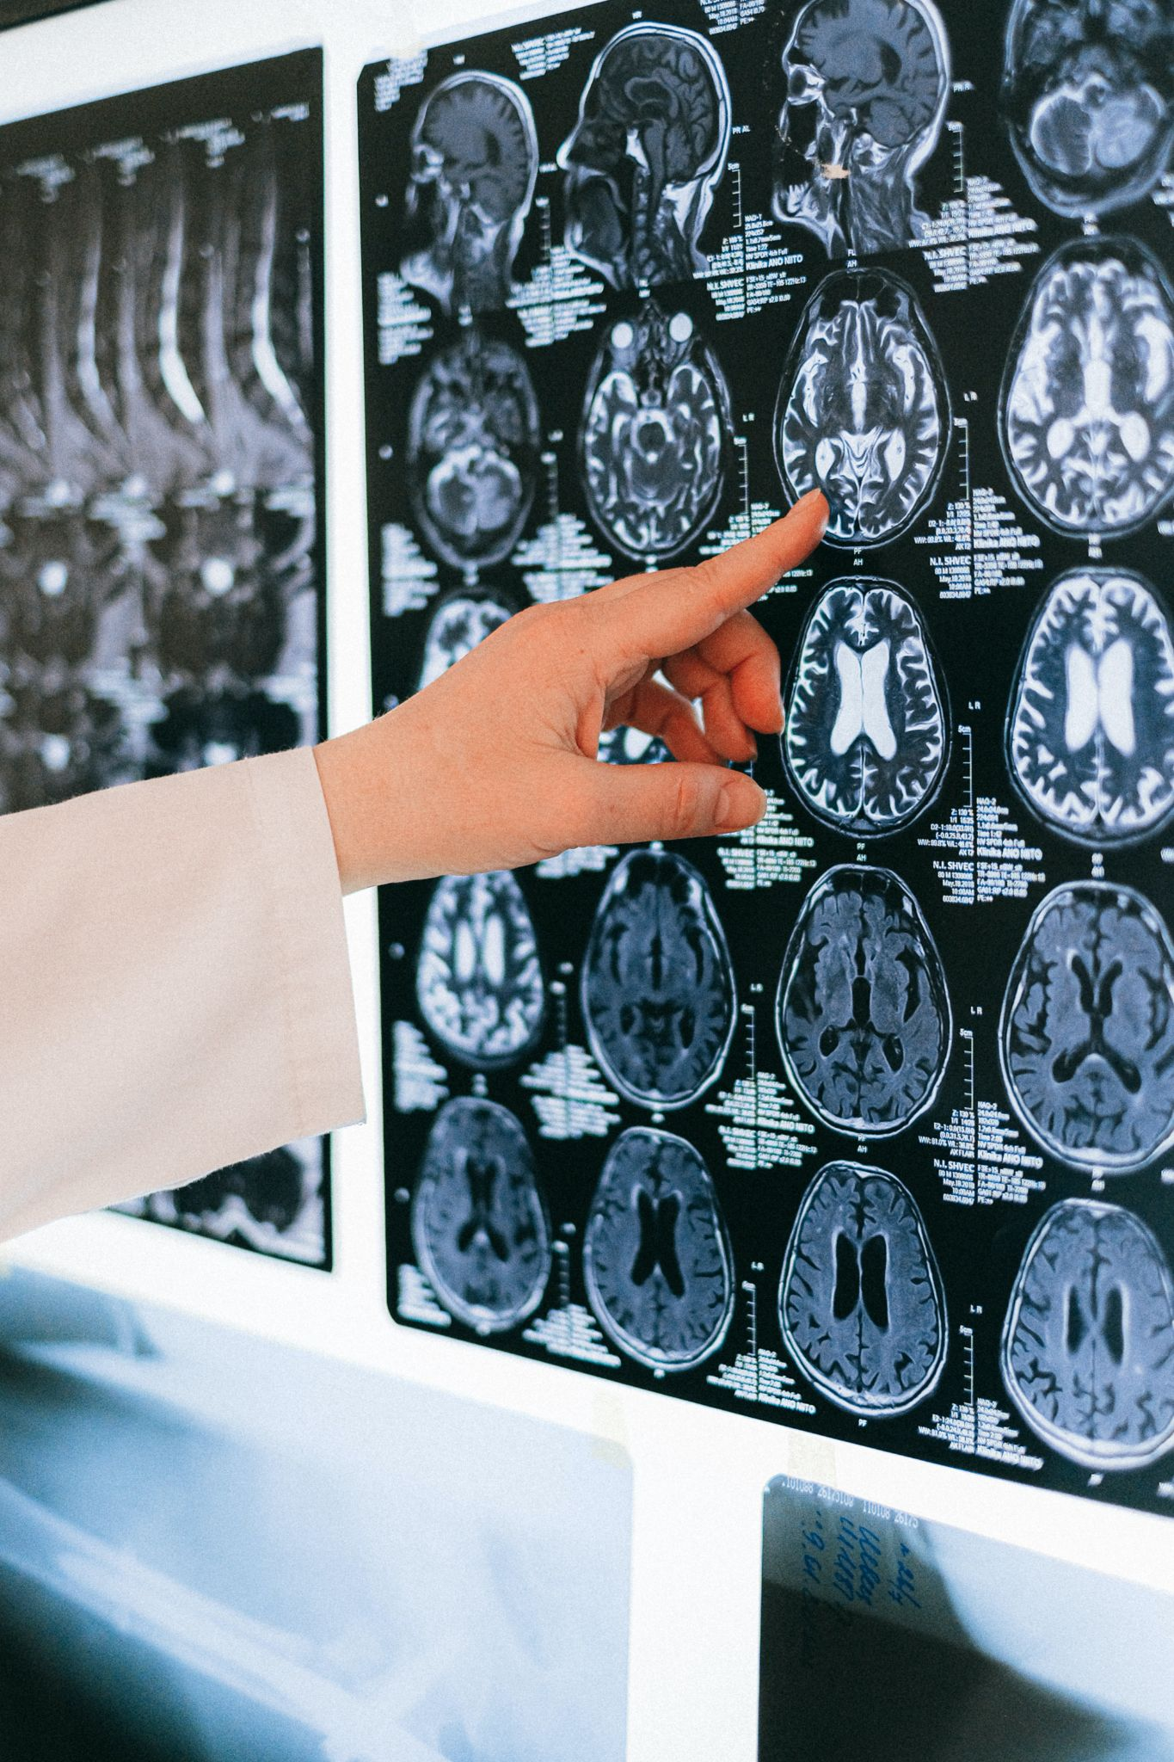
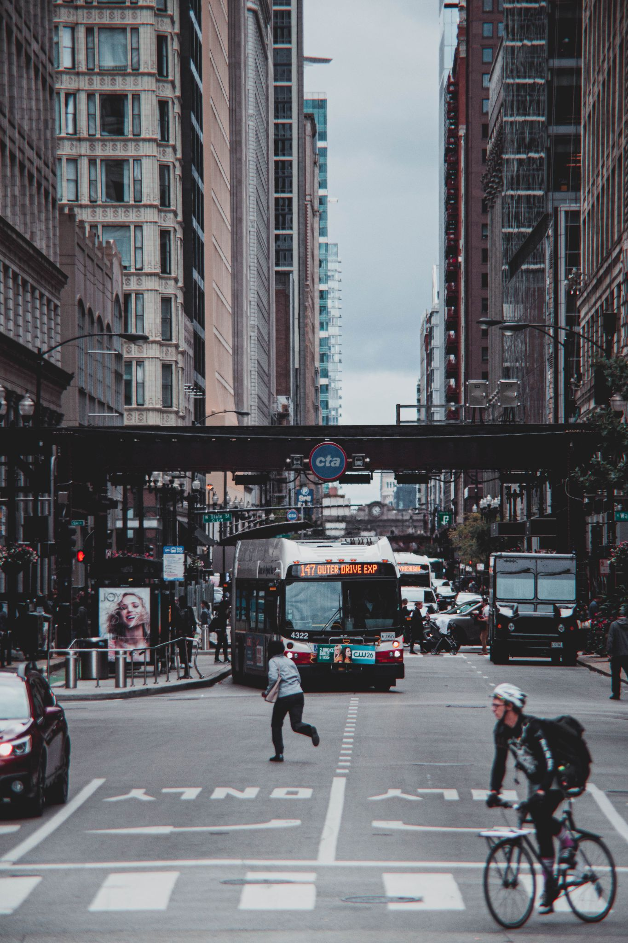
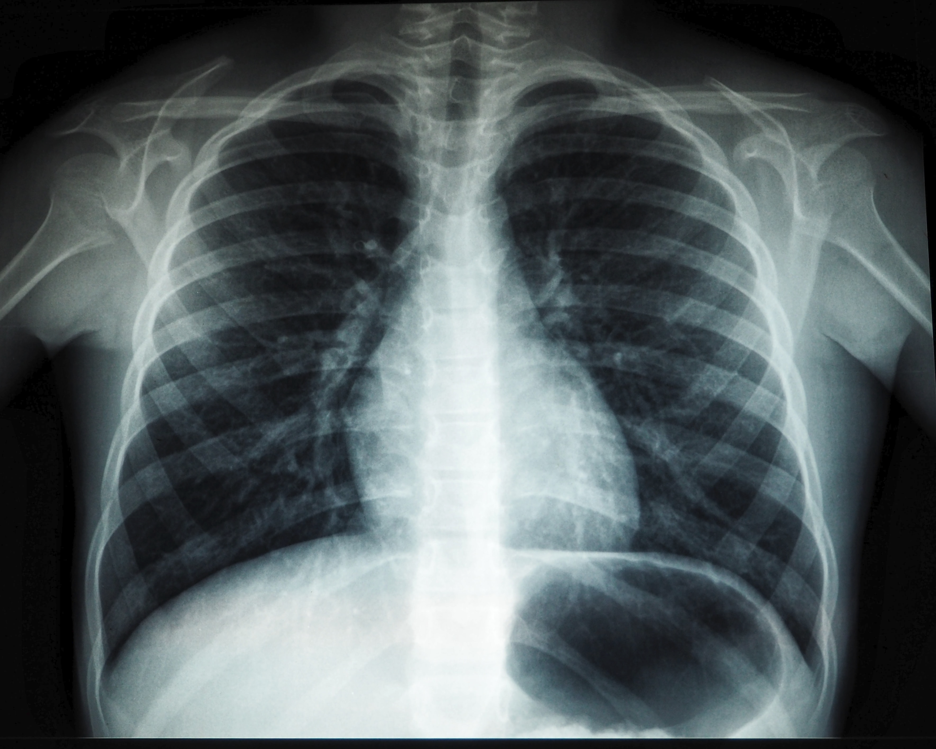
Computer Vision
Bus
Car
Bike
Person
Notes:
Source of images:
https://unsplash.com/photos/tHS9j3HWT1s (free to use)
https://www.pexels.com/photo/person-in-white-long-sleeve-shirt-holding-black-and-white-round-wall-decor-4226119/ (free to use)
https://www.pexels.com/photo/buses-and-biker-on-road-betweennn-buings-3041340/ (free to use)

Slide 4
Computer Vision
The computational processes of making a computer ‘see’!

Slide 5
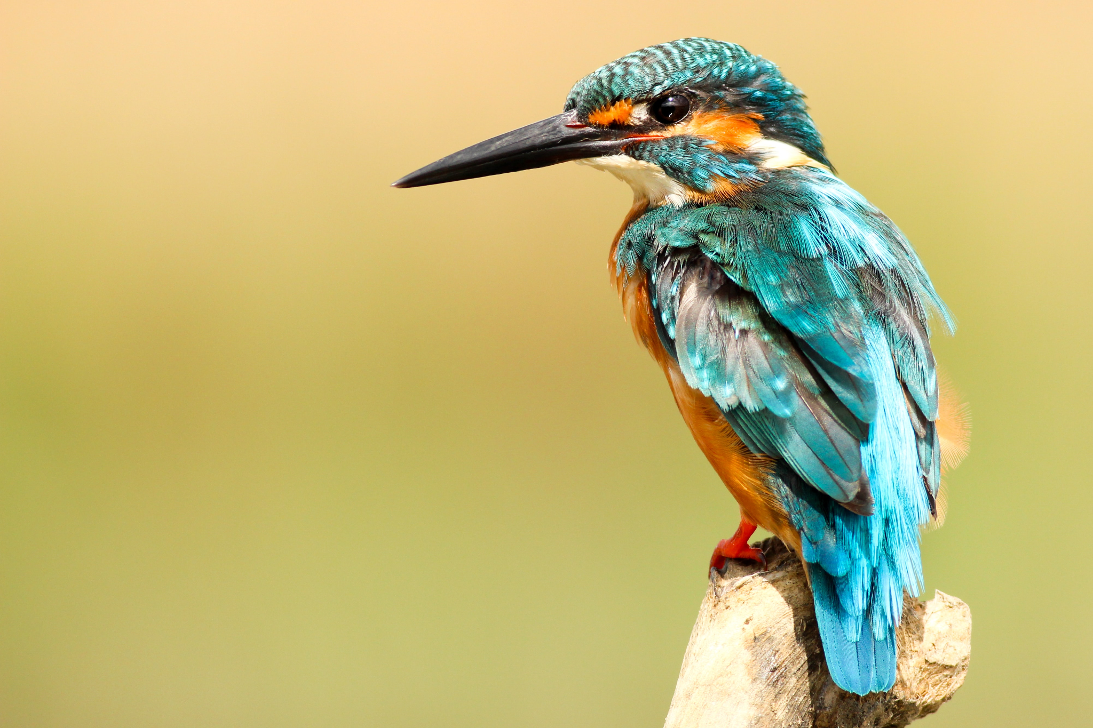

Image Representation
An image consists of a grid of pixels, with each pixel having a value or a set of values
Greyscale: 1 value per pixel (0-255 / 0-1)
Colour images (RGB): 3 values per pixel
Pixel values are considered to be the image features
2D grid is represented in code as a matrix
Notes:
Image from: https://unsplash.com/s/photos/animal (free)

Slide 6
Image Features
Using each image pixel as input value to a MLP results in extremely big networks
Image of 512 by 512 pixel: 262,144 input values
If we look at images we do not observe individual pixel values but we look at the whole context (edges, areas with similar colour, connected lines)
Input
Hidden 1
Hidden 2

Slide 7
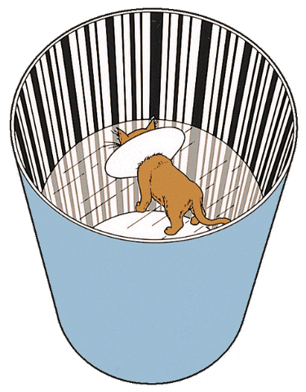
Inspiration from Nature
We have individual neurons in the visual cortex of the brain that respond to seeing specific patterns
Cats placed in a cylinder with only vertical lines directly after birth, could for the rest of their lives only see vertical lines*
This shows that vision is learned, and that we have different visual neurons in the brain for specific patterns (e.g. horizontal lines, vertical lines)
* Blakemore and Cooper 1970: https://www.youtube.com/watch?v=RSNofraG8ZE
Notes:
Picture taken from: https://computervisionblog.wordpress.com/2013/06/01/cats-and-vision-is-vision-acquired-or-innate/
Not free, but can not find similar picture on free pic sites. Slide can potentially be removed

Slide 8
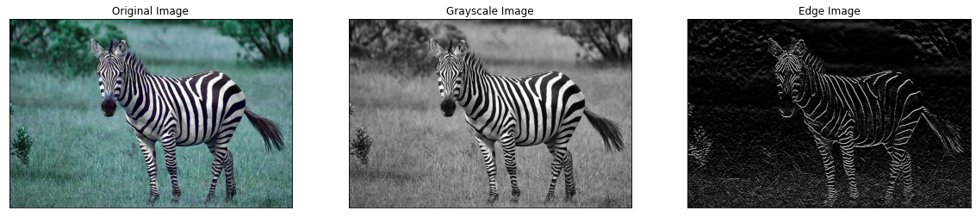
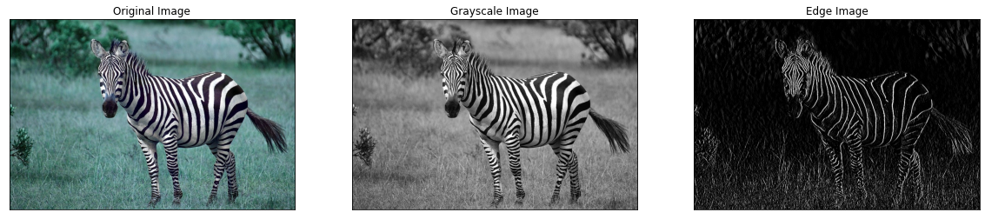
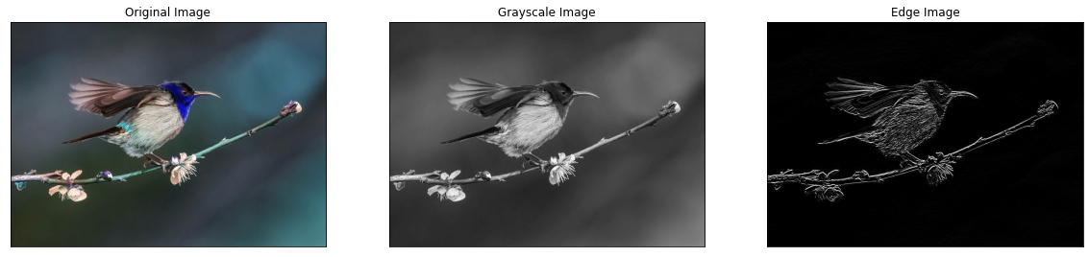
Feature extraction
Can we use the idea of detecting specific patterns individually in computer vision?
Obtain more meaningful image features than the pixel values
Horizontal edge detection
Vertical edge detection
Noise removal
Notes:
Pictures: https://pixabay.com/photos/animal-zebra-wild-wild-life-africa-4917802/

Slide 9
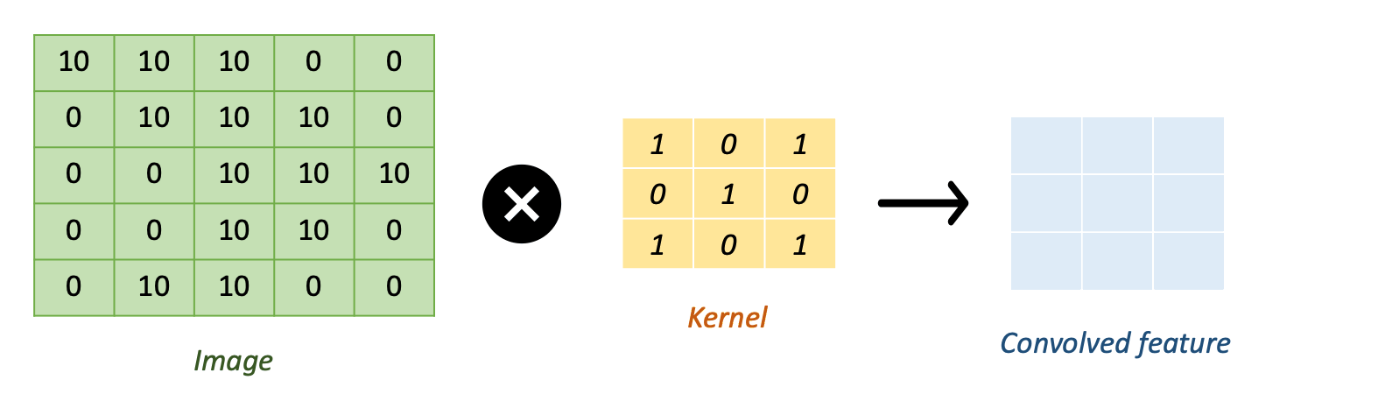
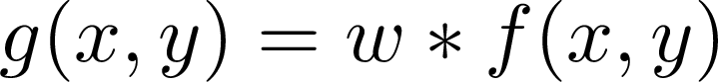
Convolutions
In a convolution, a matrix with certain weights is moved over the whole image to obtain a filtered image
This (usually small) matrix is called the kernel or filter
Convolution of image with kernel is written as:
Notes:
Pictures made by Sonal

Slide 10
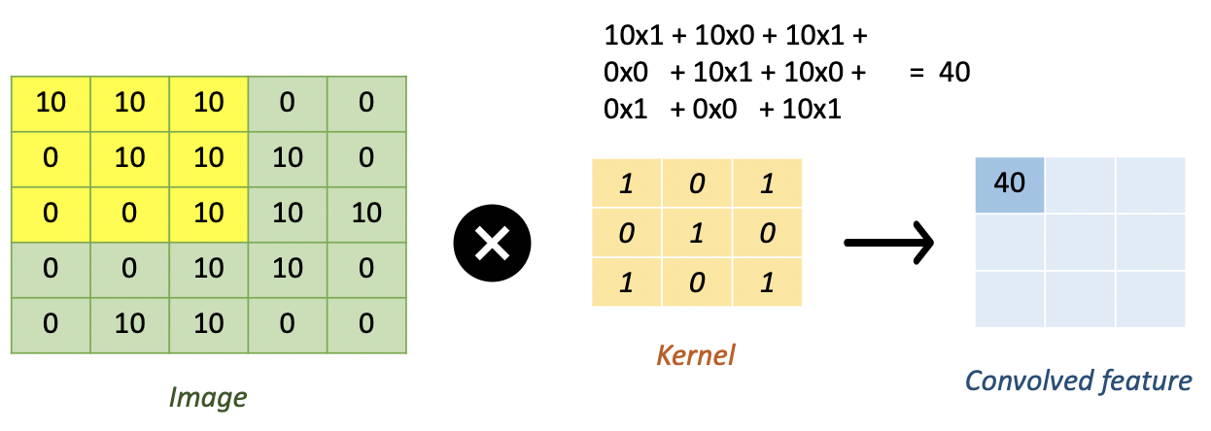

Kernel Design
New pixel values are determined by multiplying the kernel values with the pixel values and summing these together for each position
The kernel can have a variable size (3x3 in the example)

Slide 11
Kernel Design
New pixel values are determined by multiplying the kernel values with the pixel values and summing these together for each position
The kernel can have a variable size (3x3 in the example)

Slide 12

Vertical Edge Detector
1 | 0 | -1
1 | 0 | -1
1 | 0 | -1
Notes:
Pictures: https://pixabay.com/photos/animal-zebra-wild-wild-life-africa-4917802/

Slide 13
Kernel movement
Kernel stride: shift of kernel
Usually stride of 1
No stride

Slide 14
Kernel movement
Kernel stride: shift of kernel
Usually stride of 1
Stride = 1

Slide 15
Kernel movement
Kernel stride: shift of kernel
Usually stride of 1
Stride = 1

Slide 16
Kernel movement
Kernel stride: shift of kernel
Usually stride of 1
Stride = 1

Slide 17
Kernel movement
Kernel stride: shift of kernel
Usually stride of 1
and so on..
Stride = 1

Slide 18
Kernel movement
Kernel stride: shift of kernel
Usually stride of 1
Sometimes stride of 2
No stride

Slide 19
Kernel movement
Kernel stride: shift of kernel
Usually stride of 1
Sometimes stride of 2
Stride = 2

Slide 20
Kernel movement
Kernel stride: shift of kernel
Usually stride of 1
Sometimes stride of 2
Stride = 2

Slide 21
Kernel movement
Kernel stride: shift of kernel
Usually stride of 1
Sometimes stride of 2
Out of image bounds - Problem?
Stride = 2

Slide 22
Kernel movement
Kernel stride: shift of kernel
Usually stride of 1
Sometimes stride of 2
Kernel padding:
Usually zero padding
Out of image bounds - Problem?
Solved by padding
Stride = 2

Slide 23
Kernel movement
Kernel stride: shift of kernel
Usually stride of 1
Sometimes stride of 2
Kernel padding:
Usually zero padding
Padding of 2 around the image
No stride

Slide 24
Kernel movement
Kernel stride: shift of kernel
Usually stride of 1
Sometimes stride of 2
Kernel padding:
Usually zero padding
Padding of 2 around the image
0 | 0 | 0
0 | 0 | 0
0 | 0
Stride = 2

Slide 25
Kernel movement
Kernel stride: shift of kernel
Usually stride of 1
Sometimes stride of 2
Kernel padding:
Usually zero padding
Padding of 2 around the image
 |  | 0 | 0 | 0
 |  | 0 | 0 | 0
and so on..
Stride = 2

Slide 26
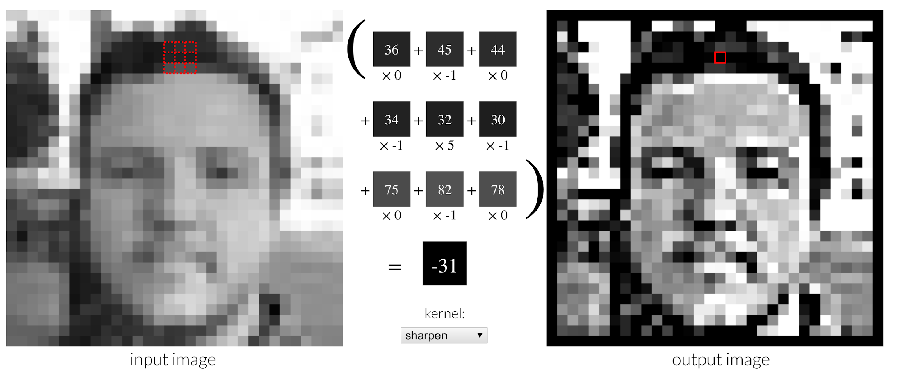
Convolution demo
Live demo: http://setosa.io/ev/image-kernels/
Notes:
Optional to do demo during lecture, it is also referenced in the notebook as a task

Slide 27
Breakout Room
[10 min] Complete Task 1 in the Notebook

Slide 28

Convolutional Neural Network
Combine multiple convolutions into a network
In each layer, a number of kernels is applied
Each kernel results in a feature map (i.e. edge map)
Values of the kernels are the weights of the network
Learned by training
flattened features
conv+non-lin
output
conv+non-lin
down-sample
conv+non-lin
down-sample
flatten
dense

Slide 29
Down-Sampling
flattened features
conv+non-lin
output
conv+non-lin
down-sample
conv+non-lin
down-sample
flatten
dense

Slide 30
Down-Sampling
Feature maps resulting from convolutional layers need to be eventually aggregated into a single prediction
This can be done by down-sampling between conv layers to gradually reduce dimensionality
Most commonly used down-sampling operation: max-pool
Move kernel over image and keep maximum value
Usually kernel size of 2x2 and stride of 2
4 | 1 | 2 | 8
9 | 2 | 7 | 1
2 | 5 | 3 | 1
0 | 3 | 1 | 2
Max-pool
9 | 8
5 | 3

Slide 31
Dense Layers
flattened features
conv+non-lin
output
conv+non-lin
down-sample
conv+non-lin
down-sample
flatten
dense

Slide 32
Dense Layers
To aggregate information into prediction after the final convolutional layer dense layers can be used
Dense layer connect all input to all output (= standard layer in MLP), can also be called fully-connected layer
Before a dense layer, the feature maps are converted into a 1D array, which is sometimes referred to as flattening
flattened features
flatten
output
dense

Slide 33
Activation Function
flattened features
conv+non-lin
output
conv+non-lin
down-sample
conv+non-lin
down-sample
flatten
dense

Slide 34
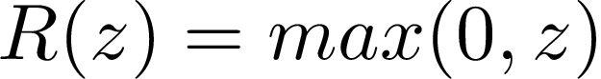
Activation Function
As for standard MLP networks, every convolution layer has an activation function
Introduces non-linearity in the network
Rectified Linear Unit (ReLU) is most commonly used, is defined as:
conv+non-lin
conv+non-lin

Slide 35
Output Layer
flattened features
conv+non-lin
output
conv+non-lin
down-sample
conv+non-lin
down-sample
flatten
dense

Slide 36
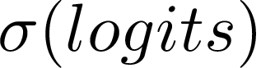
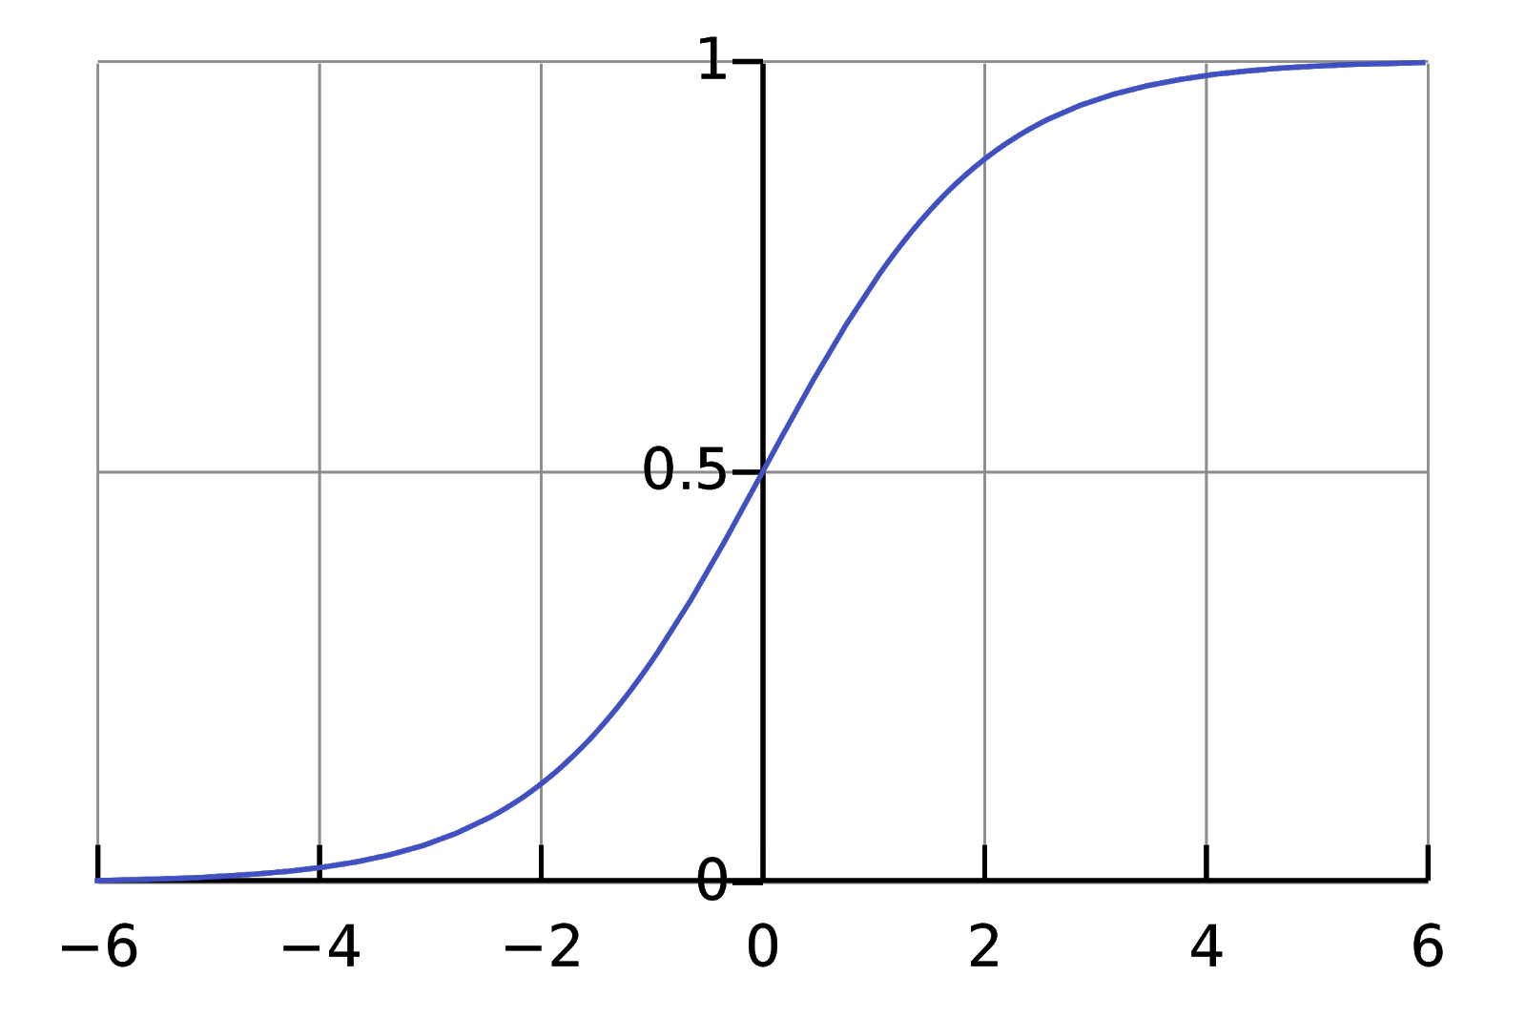
Output layer
Output layer size and activation function depend on task
Raw output of last layer (before any activation function takes place) are called logits
Binary classification
Classifying an image x as either ‘dog’ or ‘cat’
We need 1 output neuron, as:
Output probability should be between 0 and 1:
Sigmoid function (squeezes output between 0 and 1)
output layer
activation
predicted probability
Sigmoid Function

Slide 37
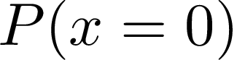
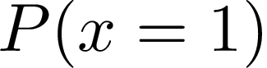
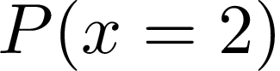
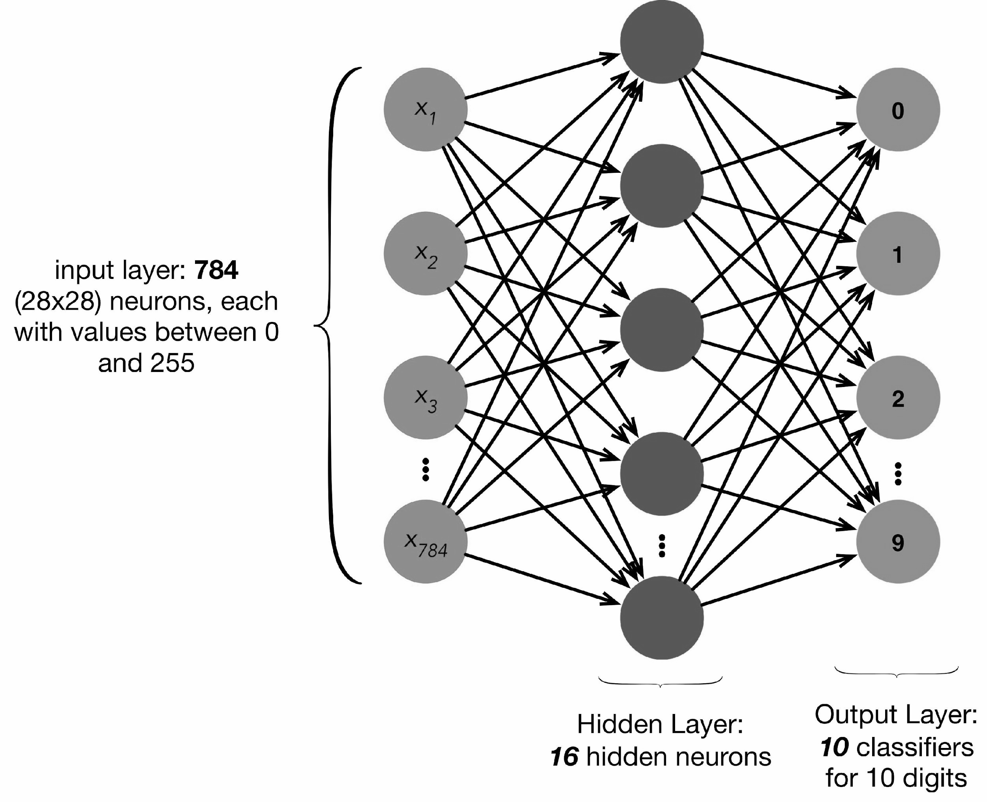
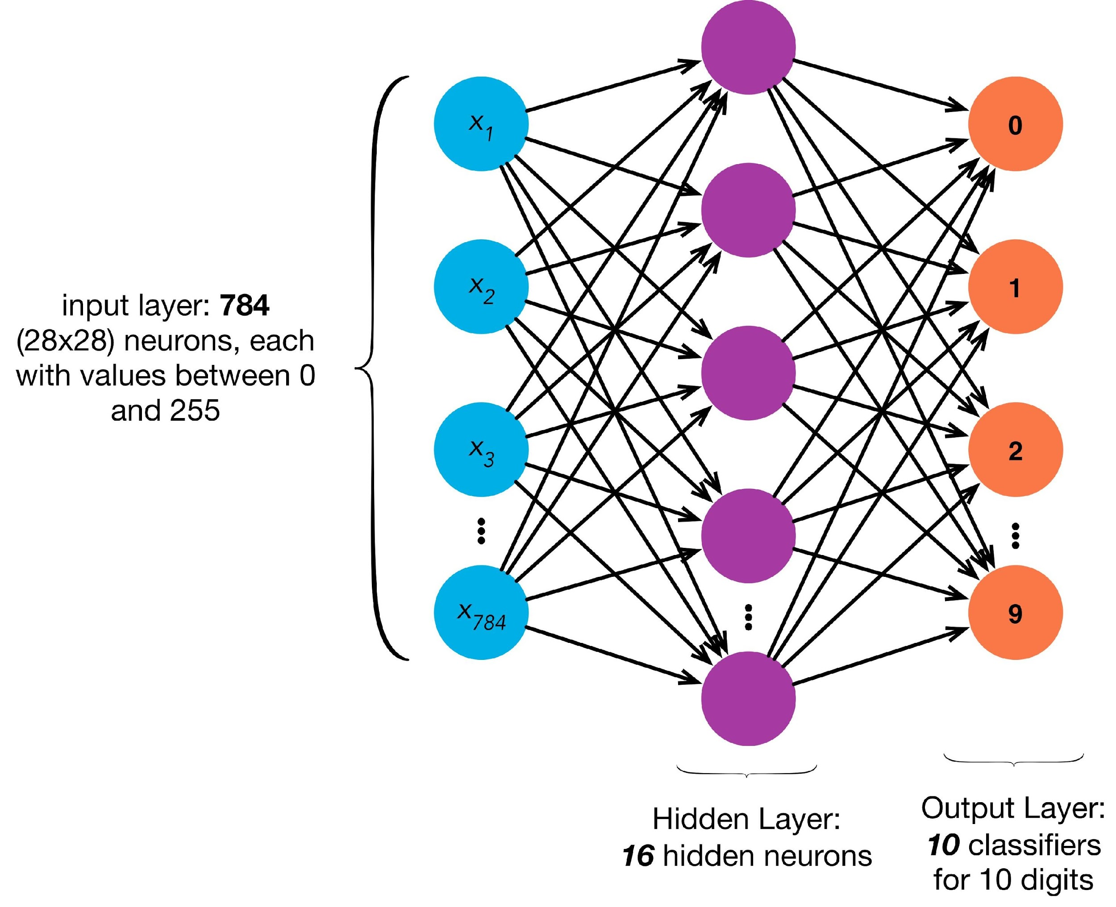
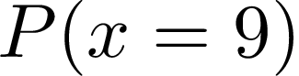
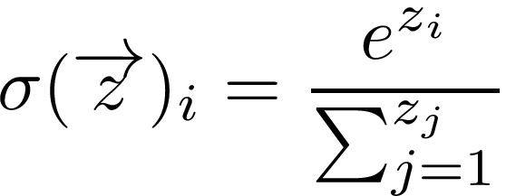
Output layer
Output layer size and activation function depend on task
Raw output of last layer (before any activation function takes place) are called logits
Multi-class classification
Classifying an image x as digit 0-9
Number of output neurons is equal to number of classes
Probabilities of individual output neurons should sum up to 1
Soft-Max function, given by:
Soft-Max
output layer
activation

Slide 38
CNN architecture
The depth of a network refers to the number of layers
The width of a conv layer refers to the number of feature maps in the layer. This corresponds to the number of learned filters in the layer.
width
depth

Slide 39
CNN architecture
The receptive field shows which input pixels have influence over a given neuron in the feature map. As we go deeper in the neural network the receptive field grows larger and larger

Slide 40
CNN architecture
The receptive field shows which input pixels have influence over a given neuron in the feature map. As we go deeper in the neural network the receptive field grows larger and larger

Slide 41
CNN architecture
The receptive field shows which input pixels have influence over a given neuron in the feature map. As we go deeper in the neural network the receptive field grows larger and larger

Slide 42
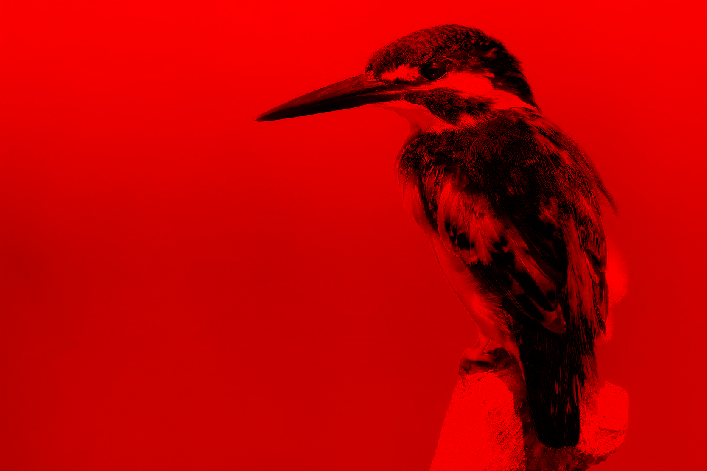
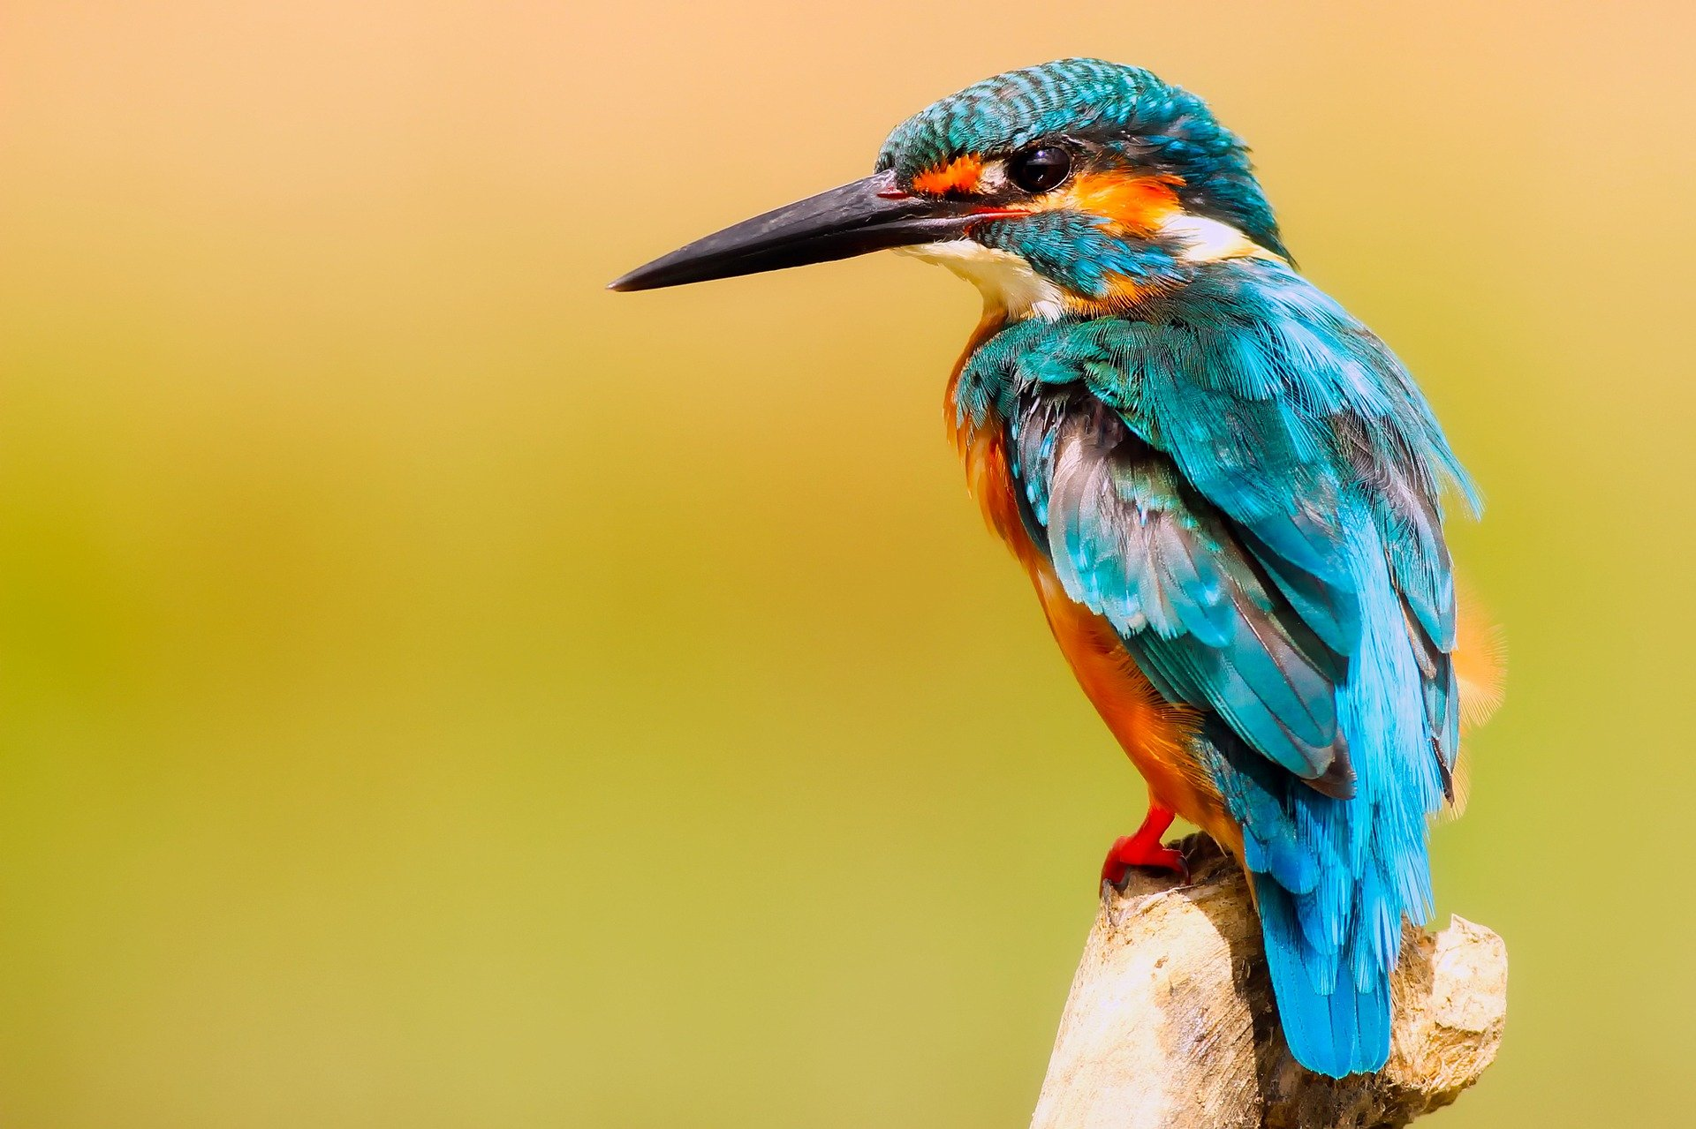
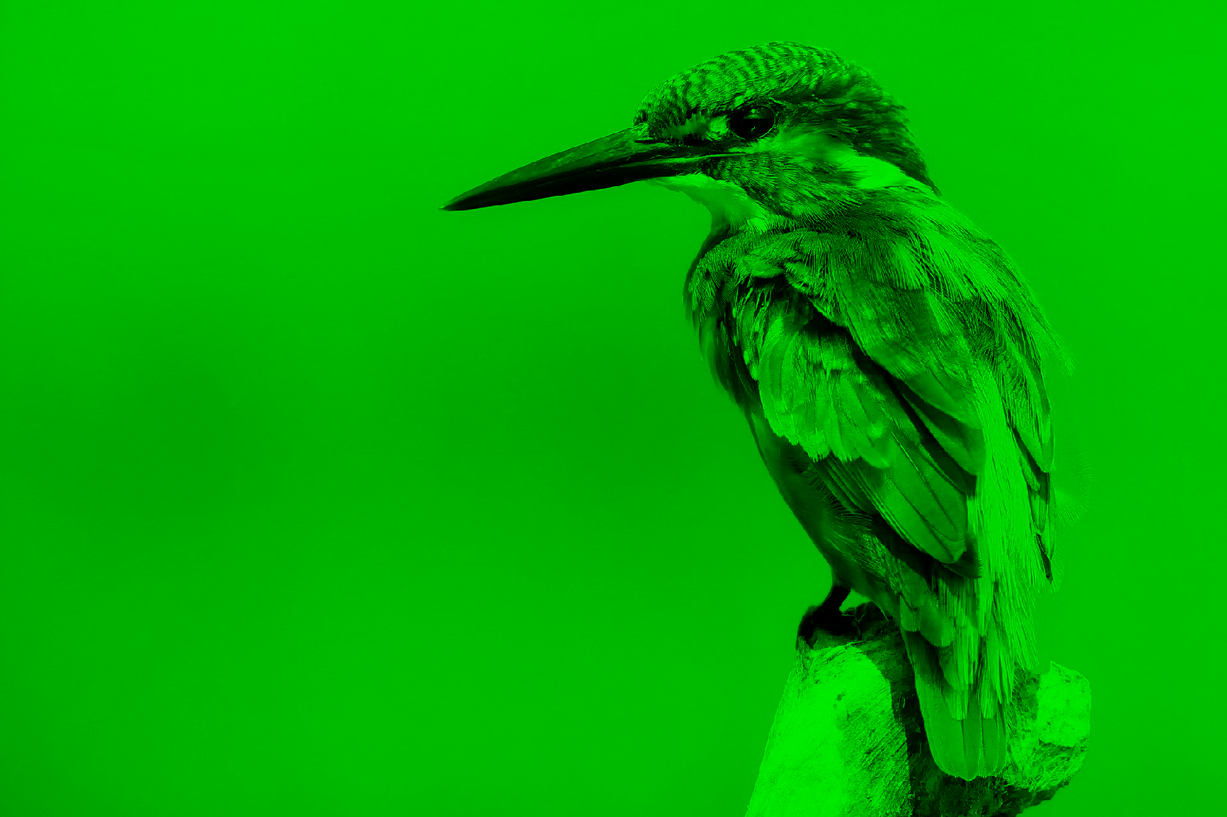
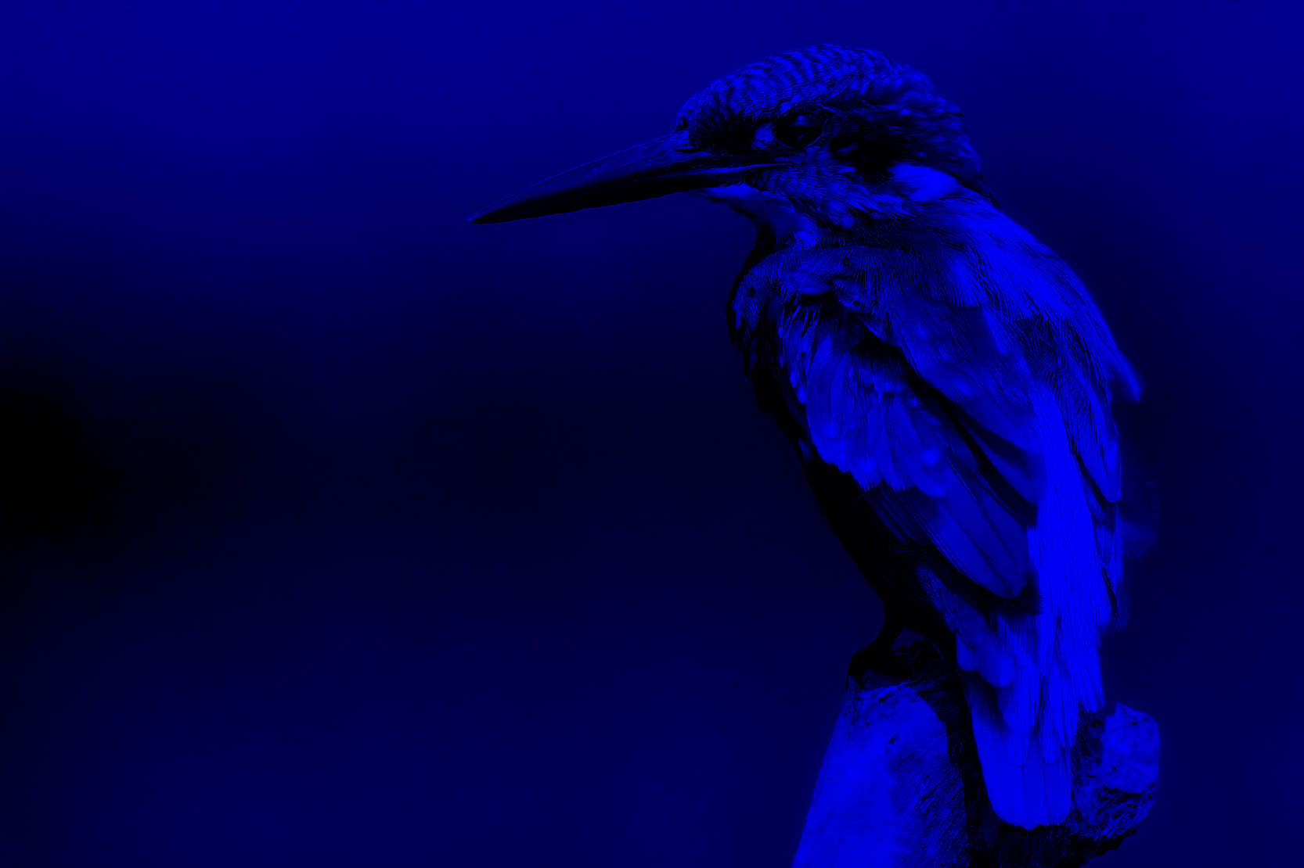
Image Dimensions
The dimensions of an image are: [C, H, W]
C is the channel dimension
H is the height of the image
W is the width of the image
For greyscale images the C is 1, because we have 1 value per location: [1, H, W]
This is equal to a dimension of [H,W] but for Pytorch computation we need the channel dimension
For color images the C can vary:
For RGB the C is 3, as we have a Red, Green and Blue component: [3, H, W]
k = 1 .. C

Slide 43
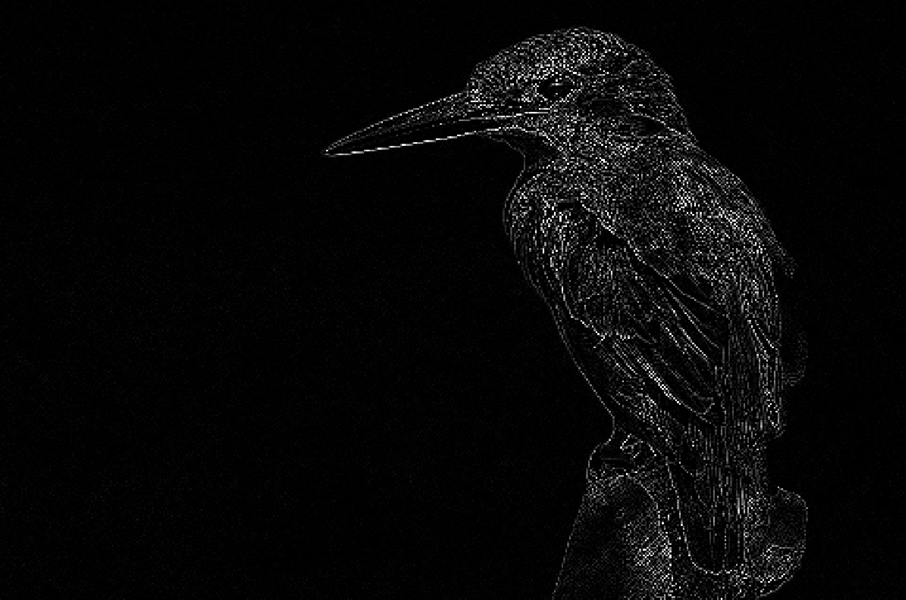
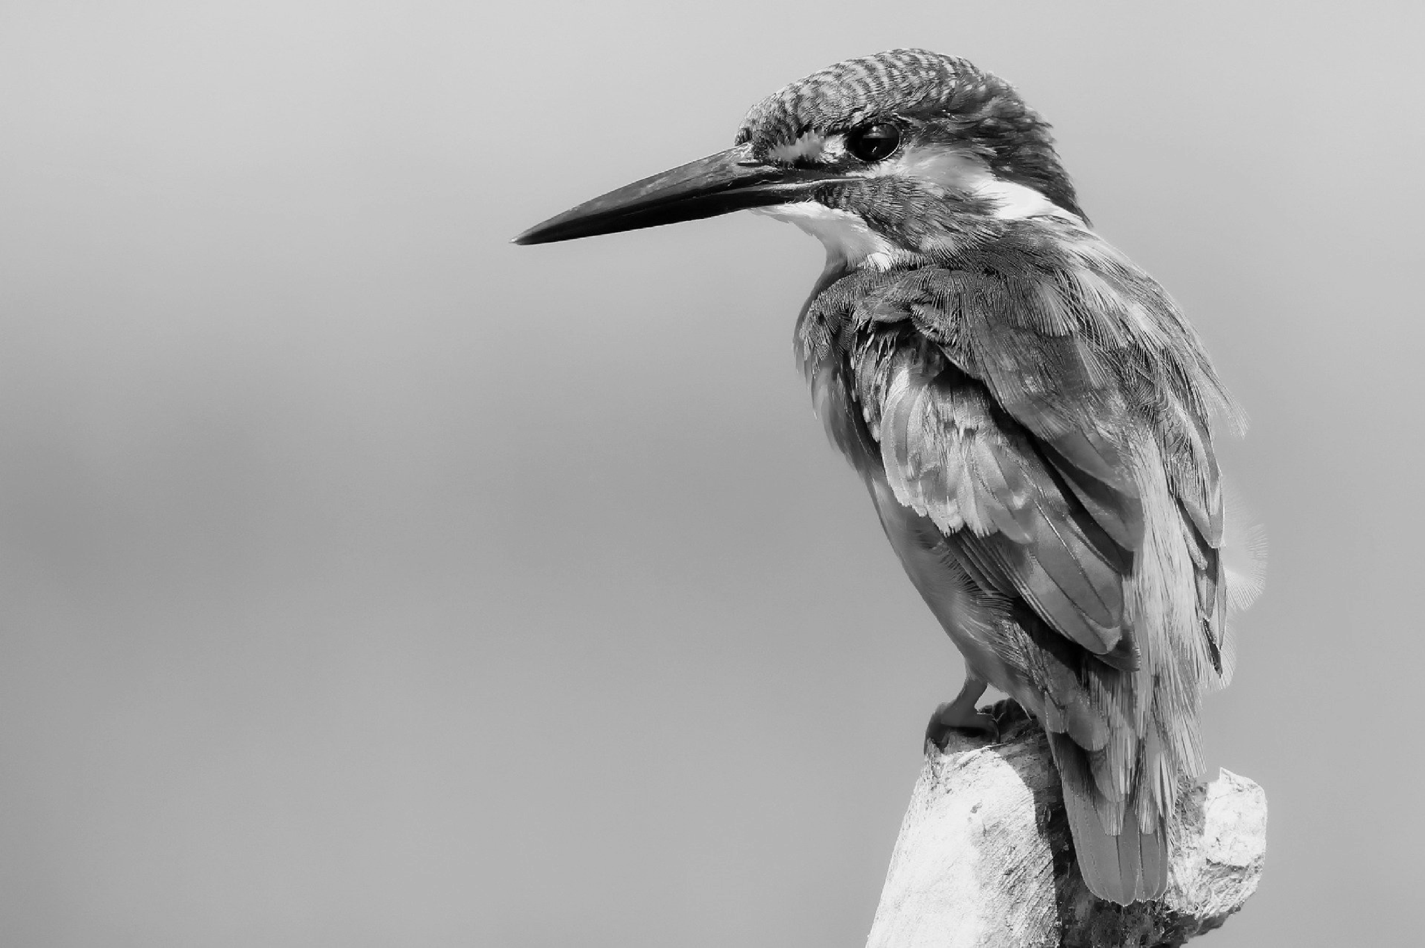
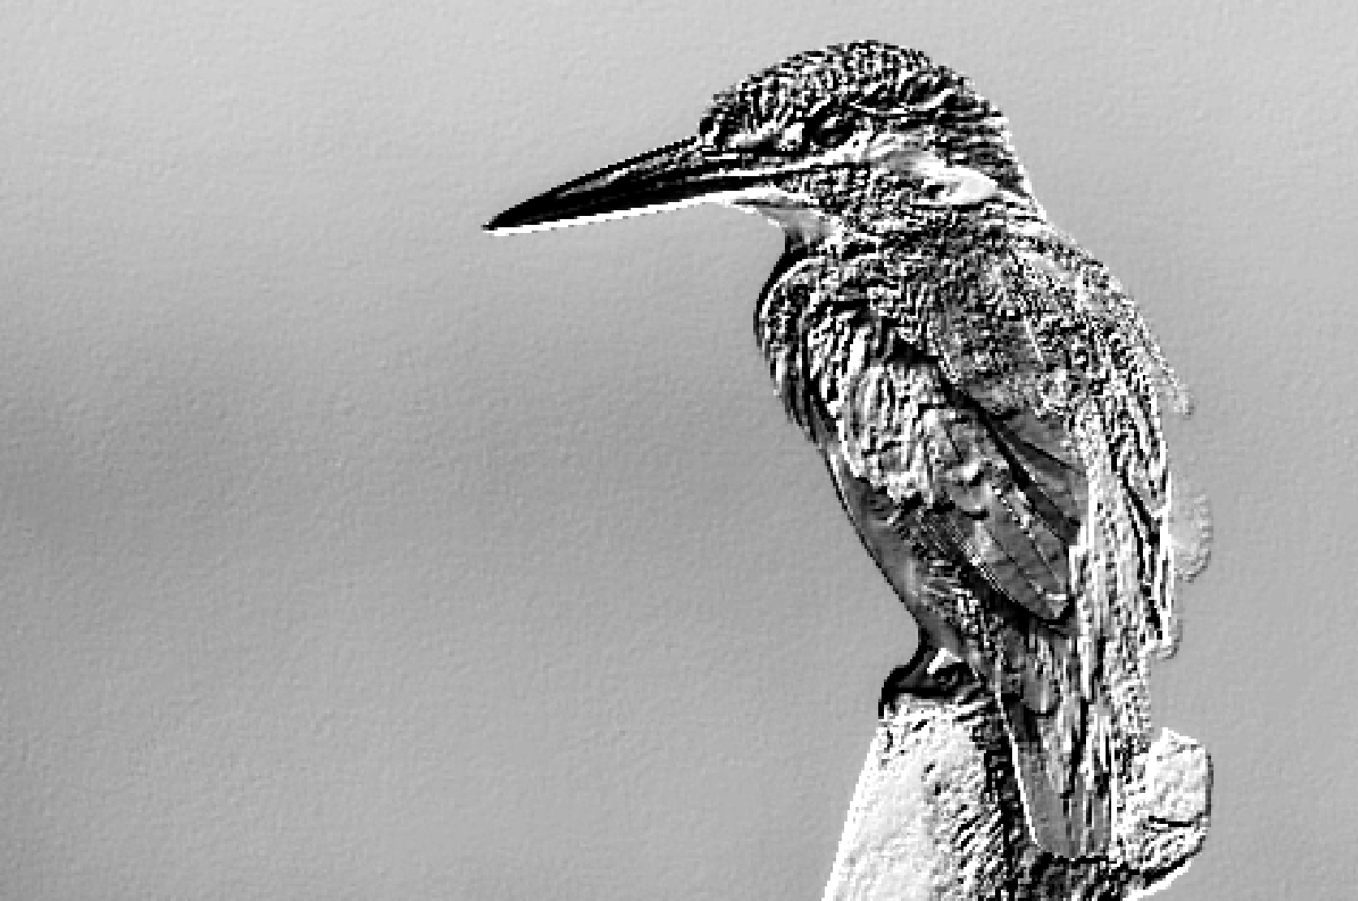
Convolution Dimensions single-channel
0 | -1 | 0
-1 | 4 | -1
0 | -1 | 0
=
*
-2 | -1 | 0
-1 | 1 | 1
0 | 1 | 2
Input:
[1, H, W]
Weight:
[2, 1, 3, 3]
Output:
[2, H, W]

Slide 44
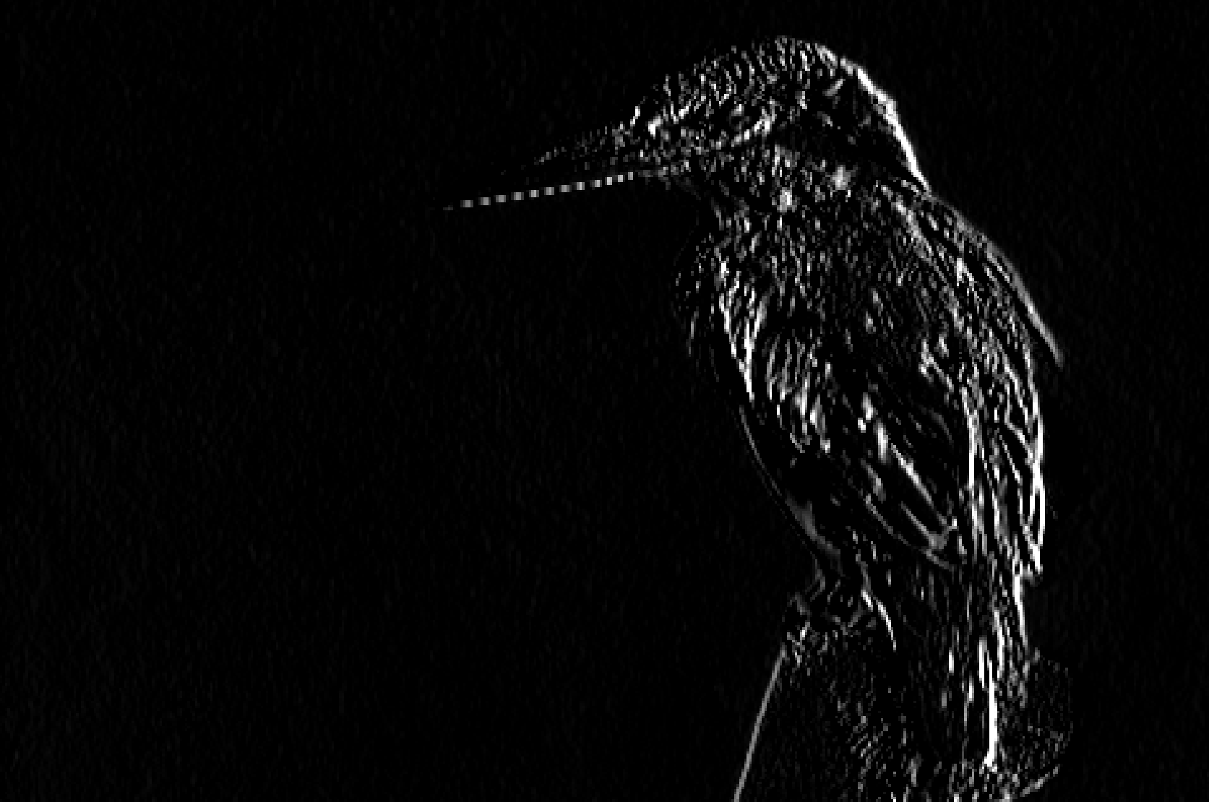
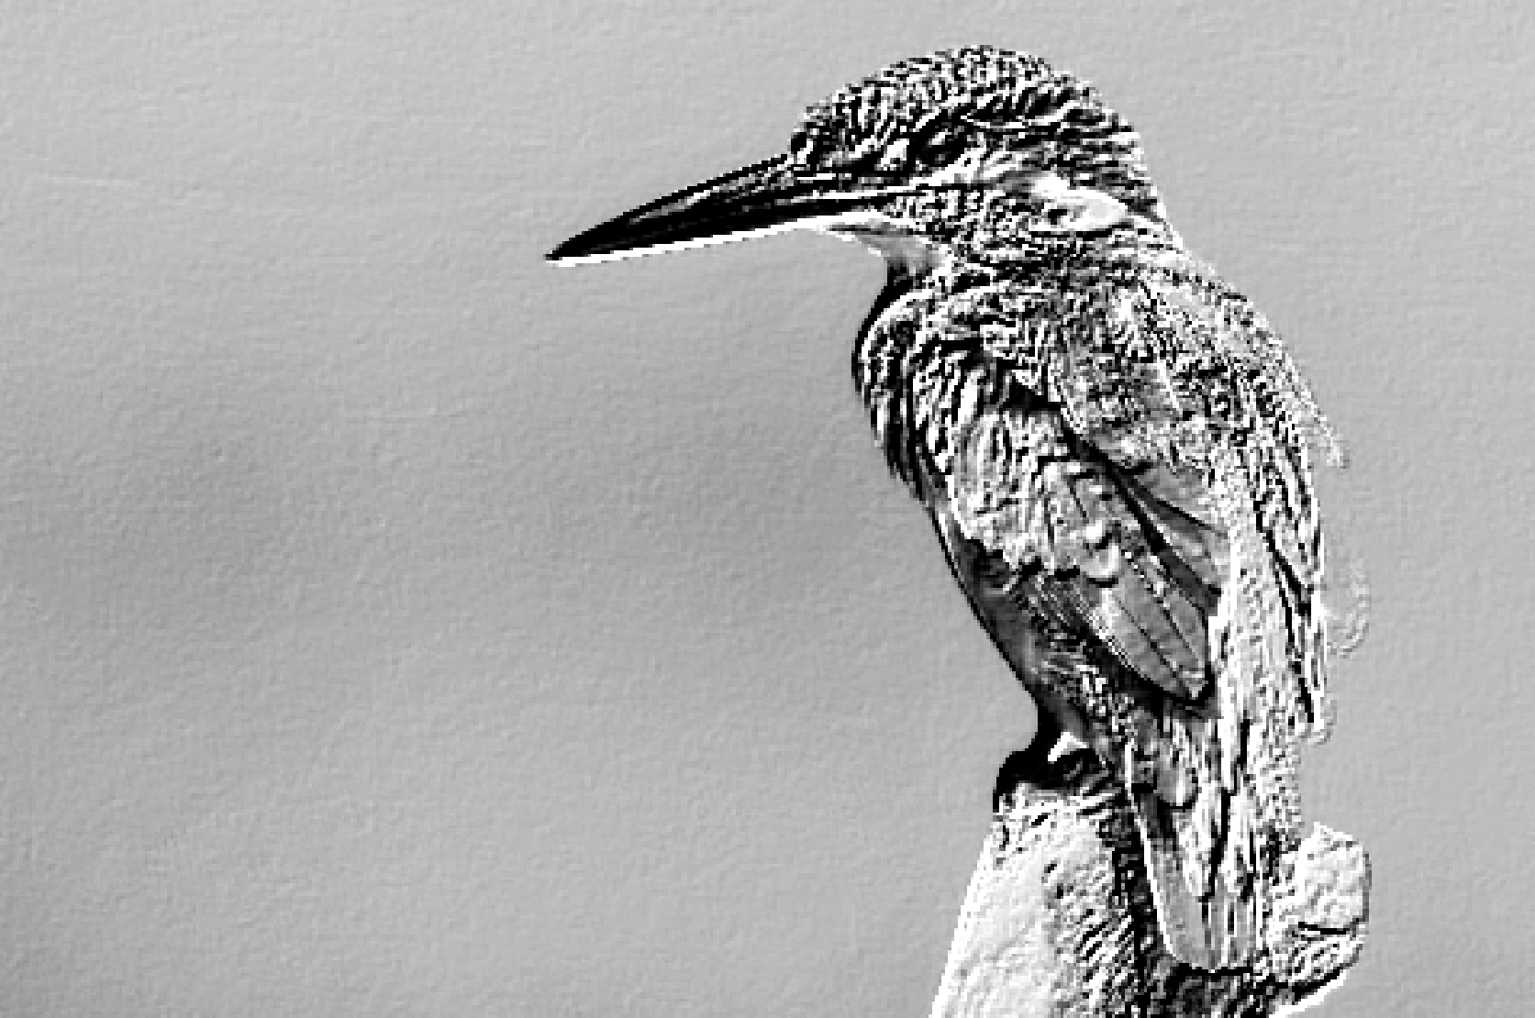
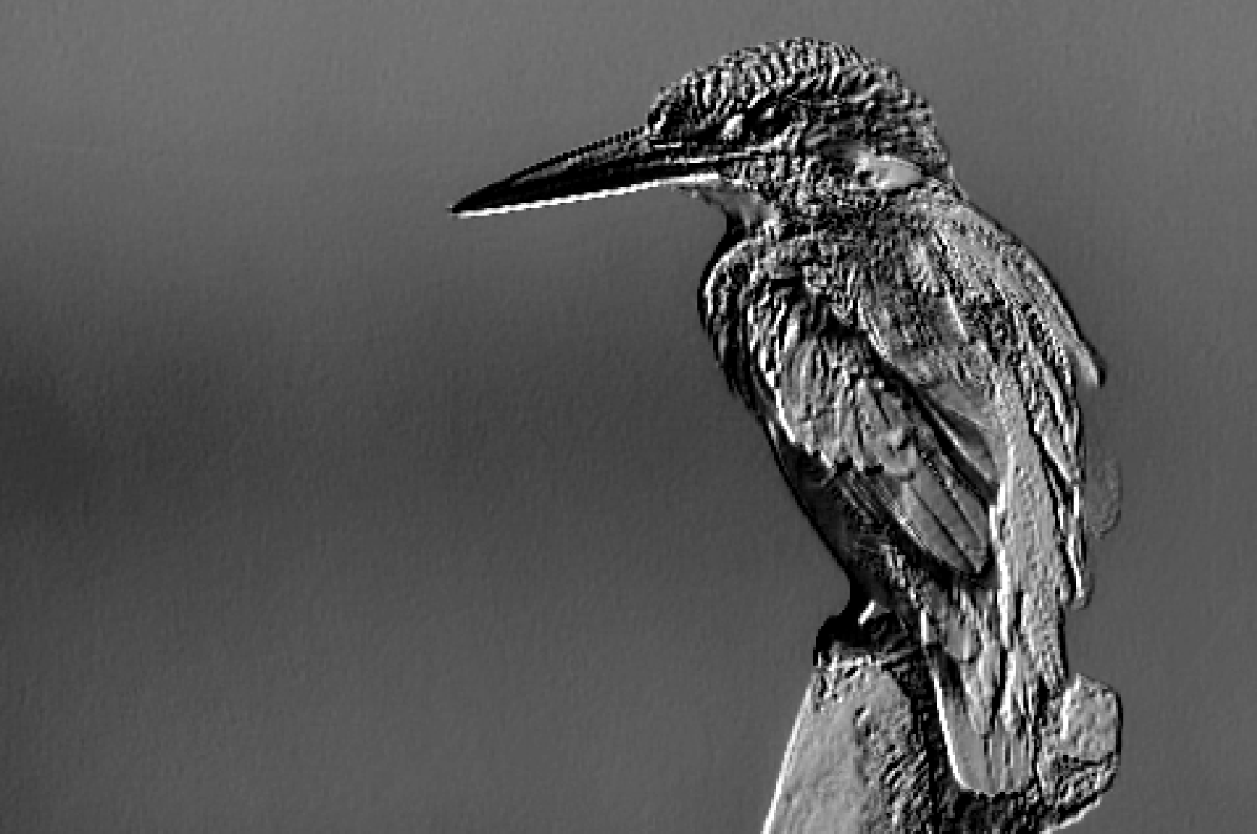
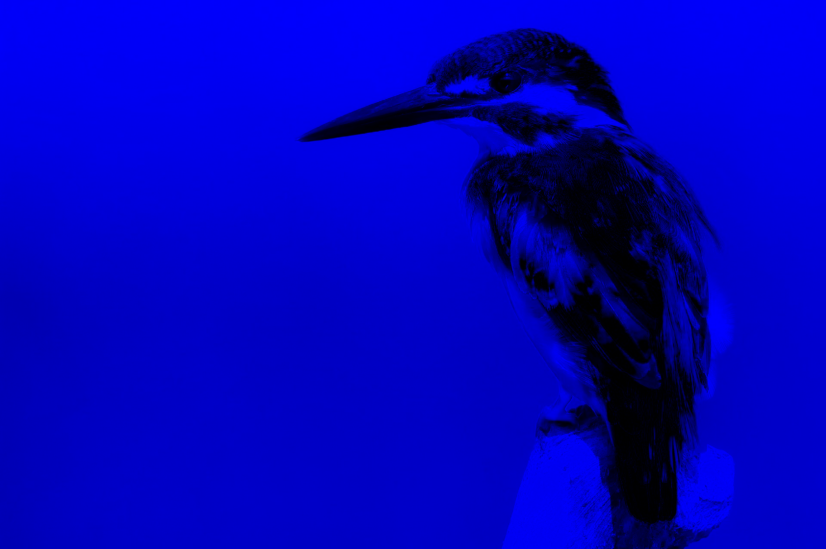
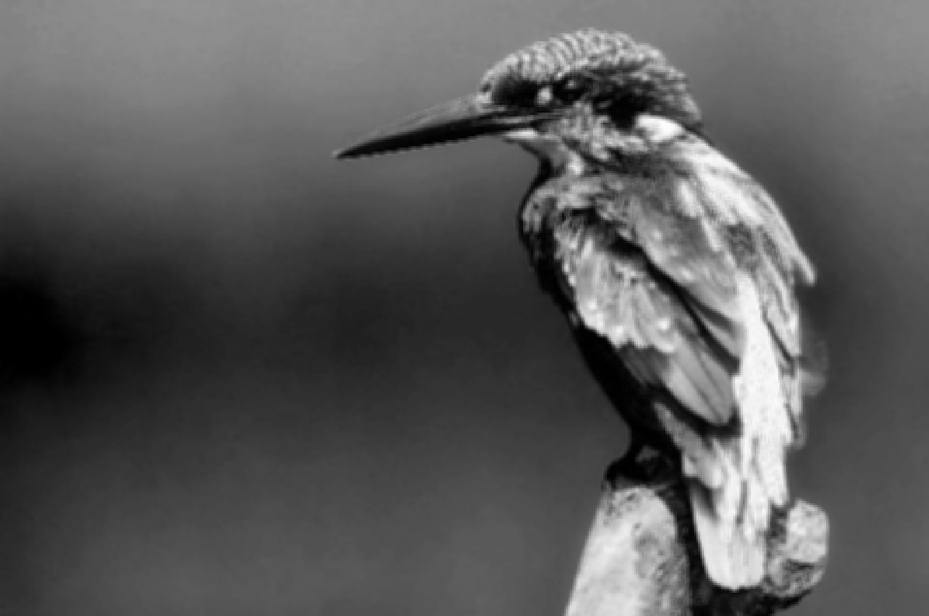
Convolution Dimensions multi-channel
-1 | 0 | 1
-1 | 0 | 1
-1 | 0 | 1
=
*
-2 | -1 | 0
-1 | 1 | 1
0 | 1 | 2
=
*
∑ =
1/9 | 1/9 | 1/9
1/9 | 1/9 | 1/9
1/9 | 1/9 | 1/9
=
*
Input:
[3, H, W]
Weight:
[1, 3, 3, 3]
Output:
[1, H, W]

Slide 45
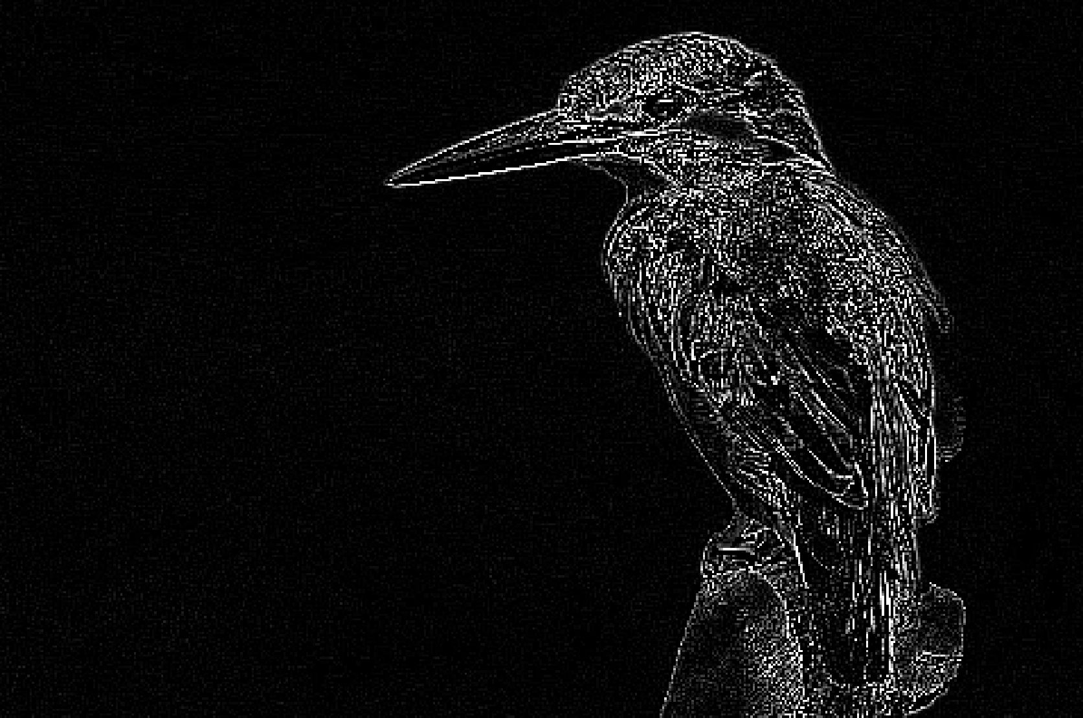
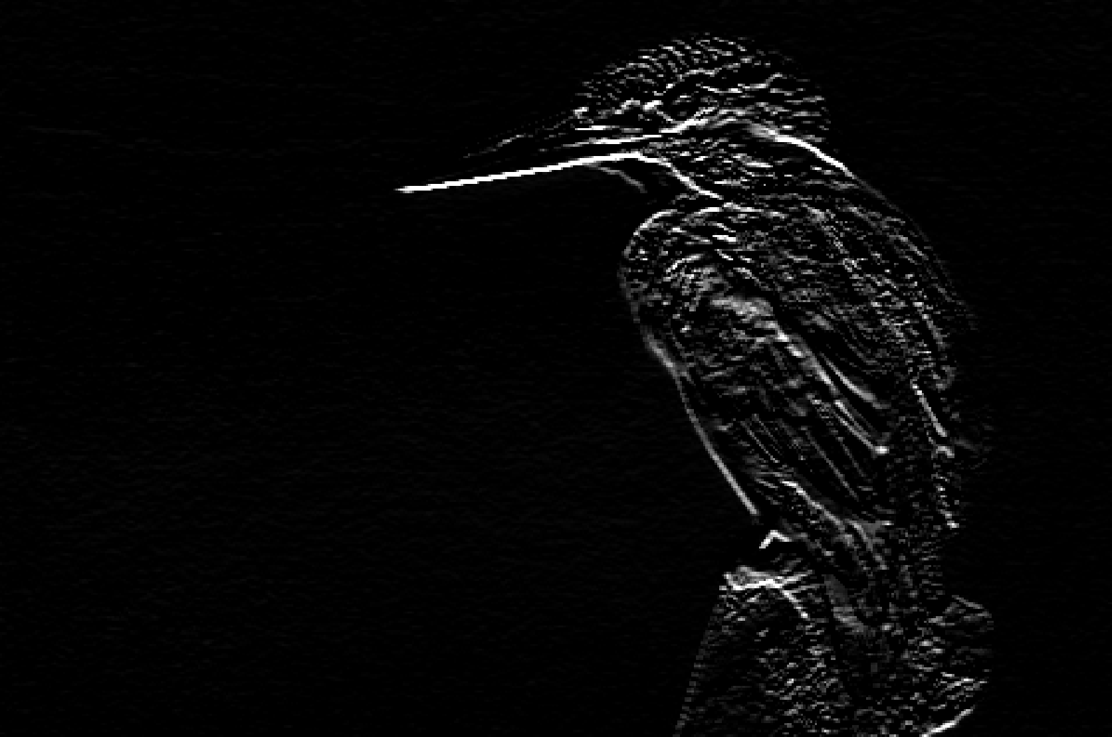
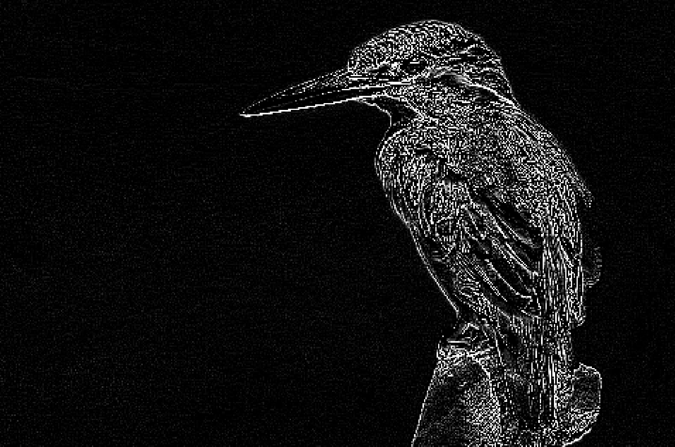
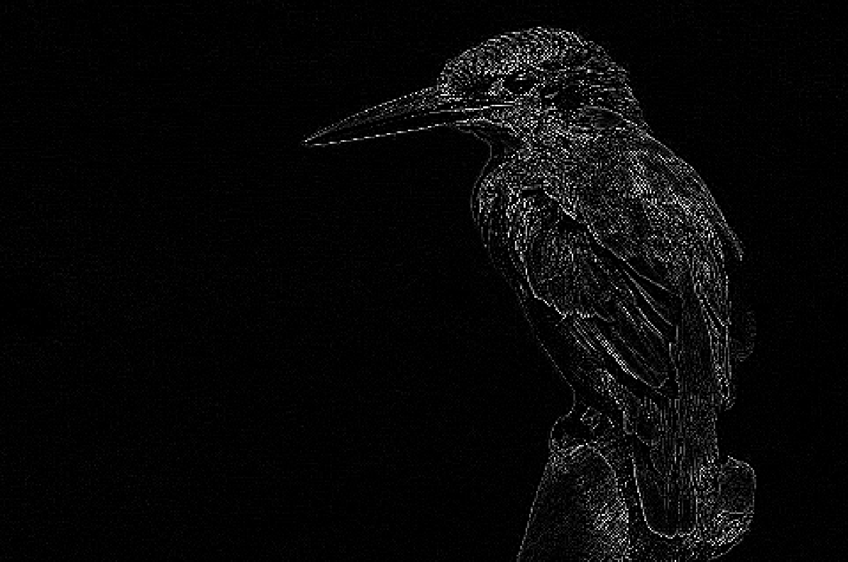
General convolution
-1 | 0 | 1
-1 | 0 | 1
-1 | 0 | 1
-1 | -1 | -1
-1 | 8 | -1
-1 | -1 | -1
∑ =
-2 | -1 | 0
-1 | 1 | 1
0 | 1 | 2
-1 | -1 | -1
0 | 0 | 0
1 | 1 | 1
∑ =
1/9 | 1/9 | 1/9
1/9 | 1/9 | 1/9
1/9 | 1/9 | 1/9
0 | -1 | 0
-1 | 4 | -1
0 | 1 | 0
Input:
[3, H, W]
Weight:
[2, 3, 3, 3]
Output:
[2, H, W]

Slide 46
General convolution
-1 | 0 | 1
-1 | 0 | 1
-1 | 0 | 1
-1 | -1 | -1
-1 | 8 | -1
-1 | -1 | -1
∑ =
-2 | -1 | 0
-1 | 1 | 1
0 | 1 | 2
-1 | -1 | -1
0 | 0 | 0
1 | 1 | 1
∑ =
1/9 | 1/9 | 1/9
1/9 | 1/9 | 1/9
1/9 | 1/9 | 1/9
0 | -1 | 0
-1 | 4 | -1
0 | 1 | 0
Input:
[3, H, W]
Weight:
[2, 3, 3, 3]
Output:
[2, H, W]

Slide 47

General convolution
*
-1 | -1 | -1
-1 | 8 | -1
-1 | -1 | -1
=
-1 | 0 | 1
-1 | 0 | 1
-1 | 0 | 1
-1 | -1 | -1
-1 | 8 | -1
-1 | -1 | -1
*
-2 | -1 | 0
-1 | 1 | 1
0 | 1 | 2
=
∑ =
-2 | -1 | 0
-1 | 1 | 1
0 | 1 | 2
-1 | -1 | -1
0 | 0 | 0
1 | 1 | 1
*
0 | -1 | 0
-1 | 4 | -1
0 | 1 | 0
=
1/9 | 1/9 | 1/9
1/9 | 1/9 | 1/9
1/9 | 1/9 | 1/9
0 | -1 | 0
-1 | 4 | -1
0 | 1 | 0
Input:
[C_{in}, H, W]
Weight:
[C_{out}, C_{in}, 3, 3]
Output:
[C_{out}, H, W]

Slide 48
Downsampling layers
Downsampling layers only affect the image dimensions
max - pool
Input:
[C_{in},H, W]
Output:
[C_{in,} H/2, W/2]

Slide 49
CNN dimensions
In Pytorch we need to specify the number of input and output channels for each convolutional layer (C_{in} , C_{out}).
It is important to match the number of input channels with the number of output channels of the previous layer
First layer:
Set C_{in} equal to the number of channels of your input images (1 for greyscale, 3 for RGB)
Choose C_{out} based on the number of feature maps you want in the first layer
For subsequent layers:
Set the C_{in} to the C_{out} of the previous layer
Choose C_{out} based on the number of feature maps you want

Slide 50
Training a CNN
Passing all our data through the network is computationally very expensive and not memory efficient (datasets can contain millions of images)
Instead we divide our data in multiple subsets, and pass these subsets after each other through our network. One subset of data is called a batch.
For each batch we perform a forward and backward pass
Passing all batches of the dataset through the network once is called an epoch

Slide 51
The Training Loop
Define the network
Load all training data into a PyTorch Tensor
For number of epochs:
For number of batches:
Give the data to the network to obtain a prediction
Compute the loss value
Perform backpropagation to obtain the gradients of the loss
Update the network parameters (the weights) based on the gradient
Forward Pass
Backward Pass

Slide 52
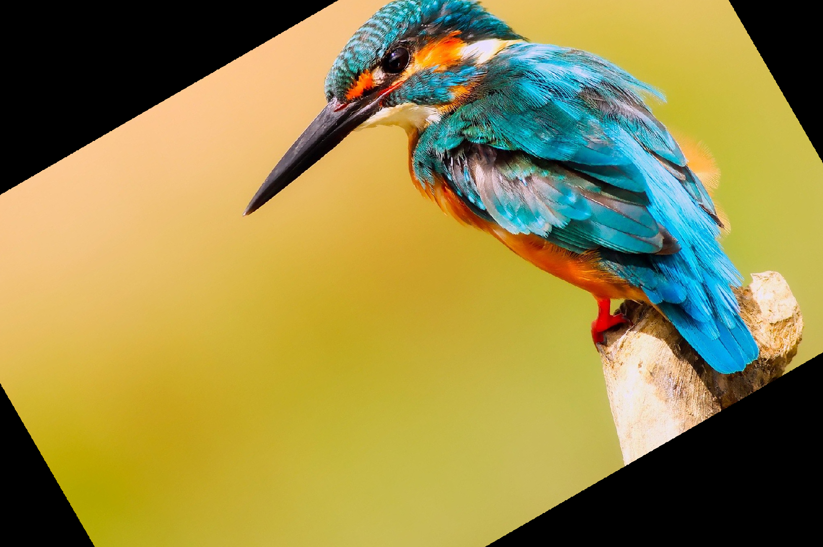
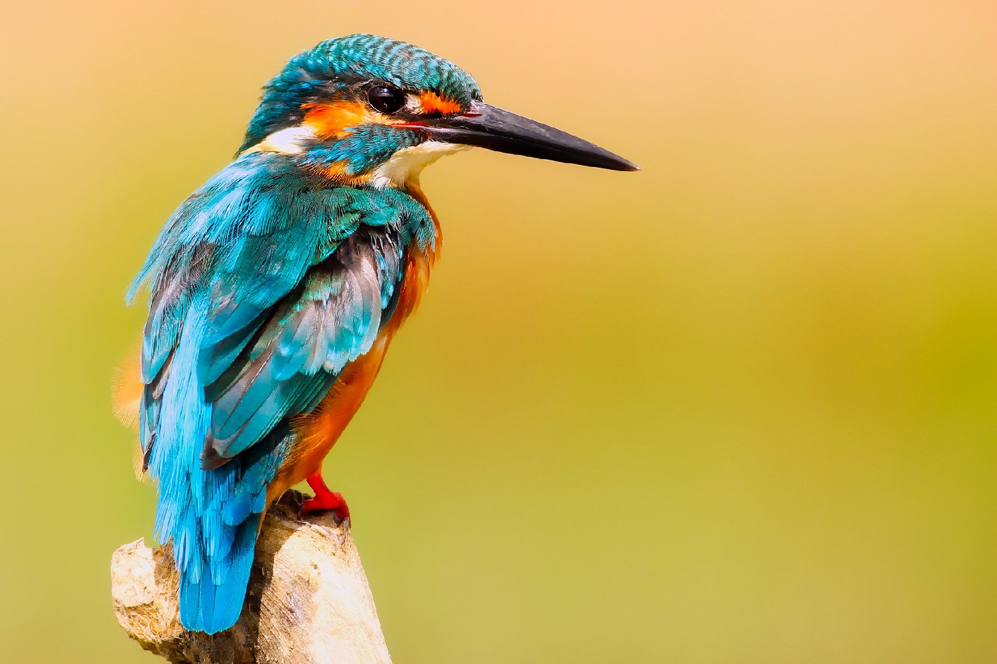
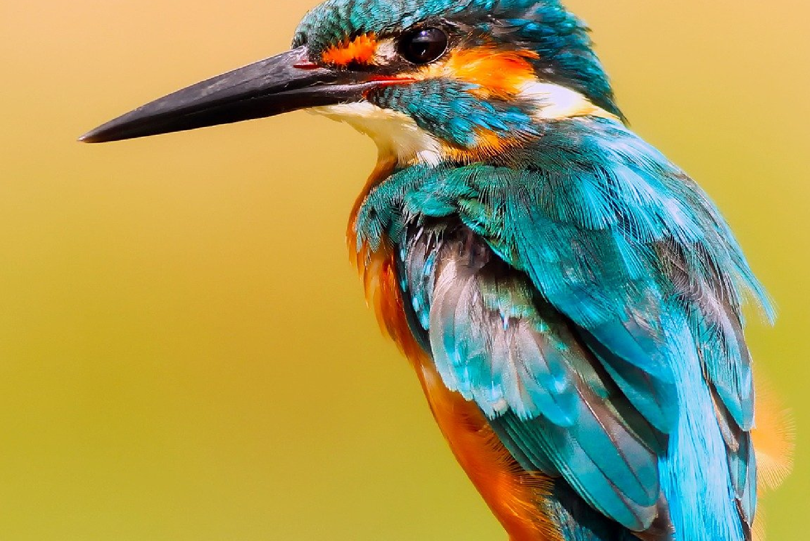
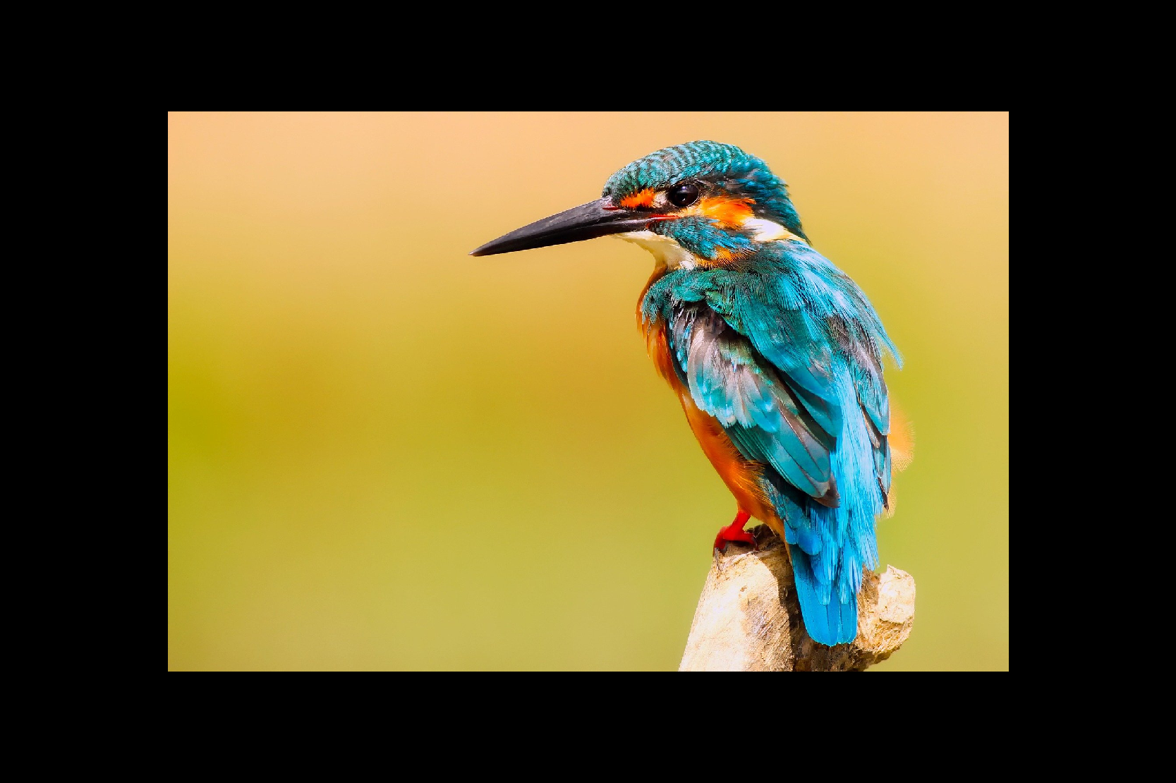
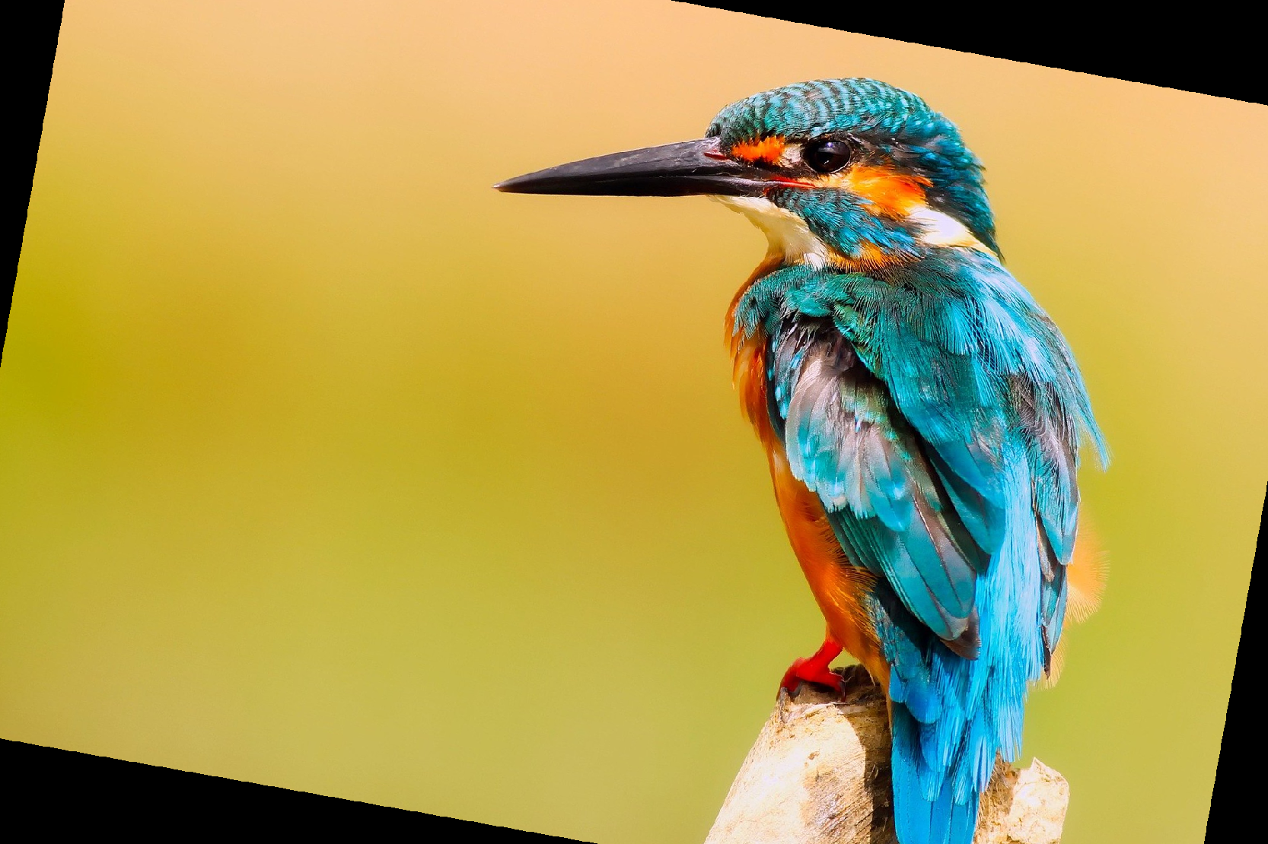
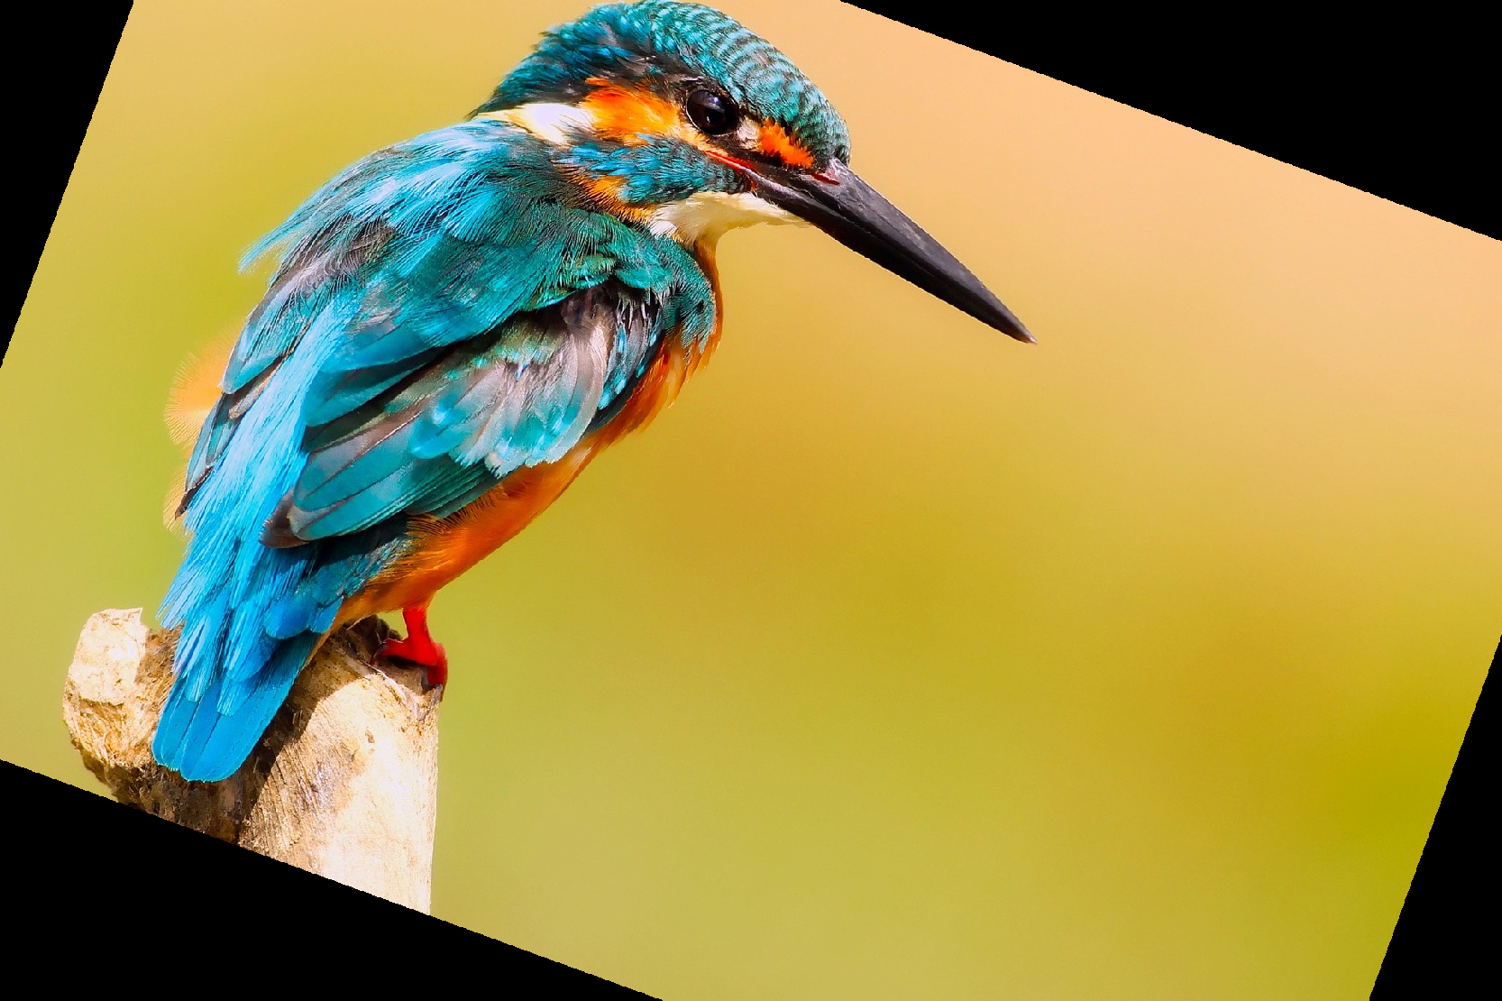
Data augmentation
We need a lot of images to get good predictions
If we have too little images, our networks will “remember” the training images and not generalize well to a validation set overfitting)
We can enlarge our dataset by applying data augmentation to the training images.
Scaling, Rotation, Flipping, etc.

Slide 53

Questions?

Slide 54

Thank You
See you soon

